Slide 1
Name : Aavani Rajesh Perumbessi
Cohort: Mark Zuckerburg

Slide 2
Google App Sheets: A Powerful Tool for Data Management
Versatile
Collaborative
Integrative
Google App Sheets is a comprehensive spreadsheet tool that goes beyond basic data organization, offering advanced features for data analysis and visualization.
Multiple users can access and edit the same spreadsheet in real-time, enabling seamless teamwork and efficient data management.
App Sheets can be integrated with other Google Suite tools, as well as third-party applications, expanding its functionality and versatility.

Slide 3
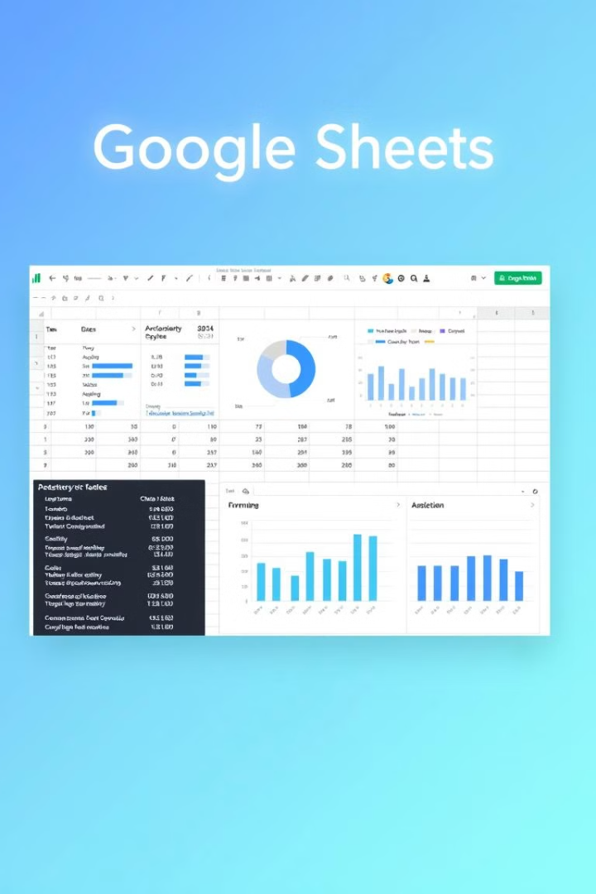
Introduction to Google App Sheets
1
Cloud-based Spreadsheet
2
Familiar Interface
The user-friendly interface closely resembles that of traditional spreadsheet software, ensuring a seamless transition for existing users.
Google App Sheets is a cloud-based spreadsheet application that allows users to create, edit, and collaborate on data-driven projects.
3
Accessible Anywhere
With the power of the cloud, App Sheets can be accessed from any device with an internet connection, enhancing productivity and flexibility.

Slide 4
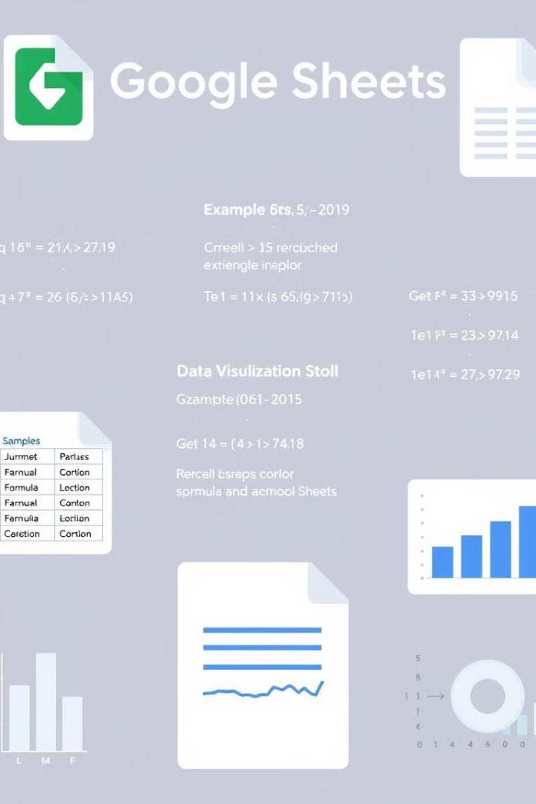
Key Features and Functionalities
Advanced Formulas
Data Visualization
App Sheets offers a wide range of powerful formulas and functions for complex data analysis and calculations.
Seamless integration with Google's data visualization tools, allowing users to create dynamic charts and graphs.
Automation
Mobile Accessibility
Automated workflows and triggers can be set up to streamline data management and reduce manual effort.
The App Sheets mobile app enables users to access and update their spreadsheets on-the-go.

Slide 5

Collaborative Capabilities
1
Share and Collaborate
Easily share your App Sheets with team members, allowing them to view, edit, and comment in real-time.
2
Version History
The built-in version history feature tracks changes and enables users to revert to previous versions if needed.
3
Simultaneous Editing
Multiple users can work on the same spreadsheet simultaneously, ensuring seamless collaboration and data synchronization.

Slide 6
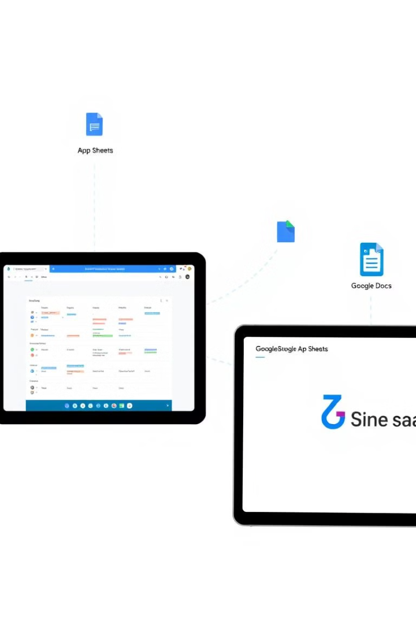




Integrating Google App Sheets with Other Apps
Google Suite
Calendar
Seamlessly integrate with other Google applications, such as Google Docs, Slides, and Forms.
Sync your App Sheets data with Google Calendar for scheduling and event management.
Zapier
APIs
Automate data transfer and workflows by connecting App Sheets with hundreds of other apps.
Leverage the powerful App Sheets API to integrate with custom-built applications and systems.

Slide 7

Thank You

